Slide 1
Double Patterning
Samuel Johnson
11/6/18

Slide 2
Outline
Background
Introduction to SADP
Deposition
Trim mask issue
Self Aligned Quadruple Patterning
SADP Problems
Via Level Manufacturing

Slide 3
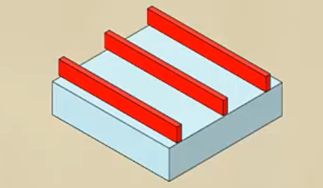
Single Patterning
Lithography and Etch
Lay photoresist
Lithography
Develop
Chris Mack Lecture 59 (CHE 323) Lithography Double Manufacturing

Slide 4
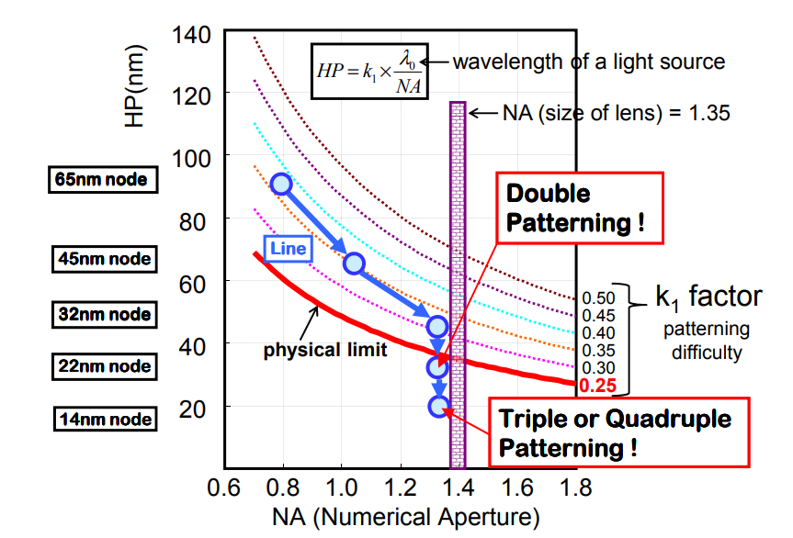
Single Patterning Resolution Limit
Theoretical Limit at 36nm
Formula is for half pitch: full pitch is 80nm
https://http://www.aspdac.com/aspdac2013/archive/pdf/3C-4.pdf/

Slide 5
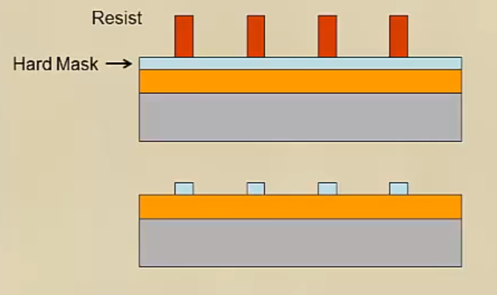
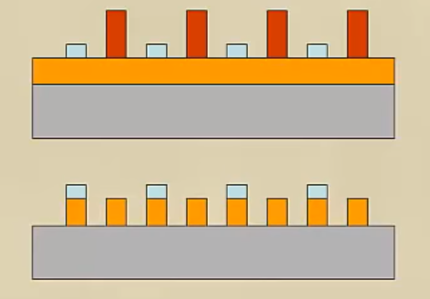
Two Lithography Double Patterning
Litho-etch-Litho-Etch
Litho-freeze-Litho-Etch
Chris Mack Lecture 59 (CHE 323) Lithography Double Manufacturing

Slide 6
Two Lithography Double Patterning
Problems
Expensive: two lithography steps
Overlay problem
https://semiengineering.com/fillcut-self-aligned-double-patterning/

Slide 7
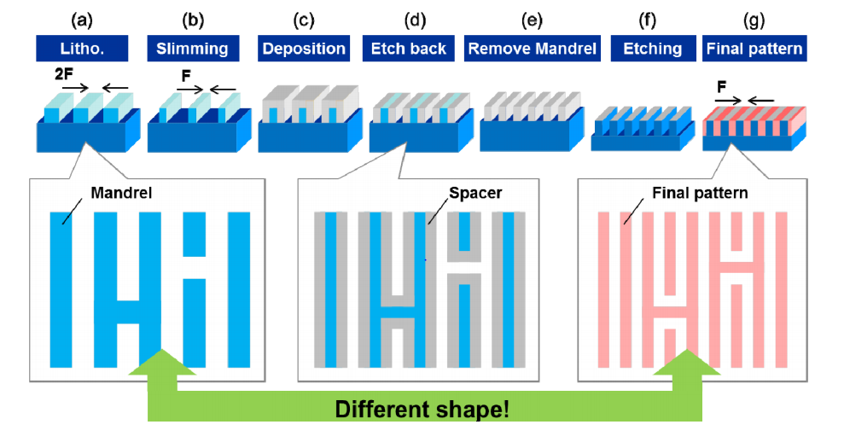
Self Aligned Double Patterning
Nakatama, K; et al. SPIE 2012

Slide 8
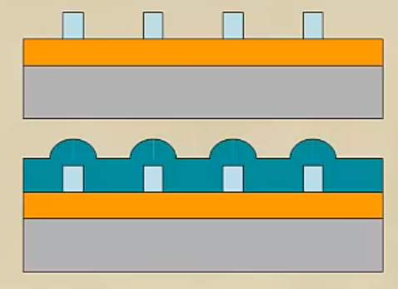
Conformal Deposition
Step 3: Deposition of sidewall material
Thickness of deposited layer is crucial
Chris Mack Lecture 59 (CHE 323) Lithography Double Manufacturing

Slide 9
Chemical Vapor Deposition (CVD)
Deposition method of choice
Able to deposit on resist material and wafer
High quality
Anisotropic process
Industrially viable
Chris Mack Lecture 59 (CHE 323) Lithography Double Manufacturing

Slide 10
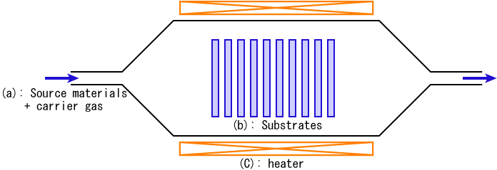
Chemical Vapor Deposition (CVD)
CVD is simple and cheap
High temperature
Meets criteria listed before

Slide 11
Etching
Etch time and conditions will determine material etched
Etching too long will result in different sized features
https://semiengineering.com/fillcut-self-aligned-double-patterning/

Slide 12
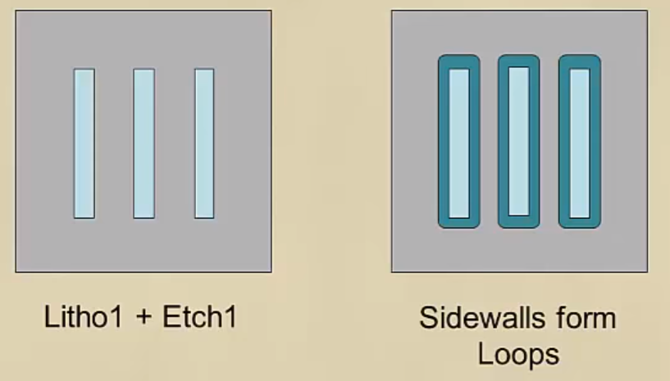
Trim Mask Issue
Sidewall forms all around patterns-loops
A problem if not desired
Chris Mack Lecture 59 (CHE 323) Lithography Double Manufacturing

Slide 13
Trim Masks
Use another lithography step to get rid of undesired material
Second mask
Only use to get rid of unnecessary patterns
https://ieeexplore.ieee.org/document/7723830

Slide 14
Trim Masks
Overlay becomes a problem
Alignment of the second mask becomes a consideration
https://ieeexplore.ieee.org/document/7723830

Slide 15
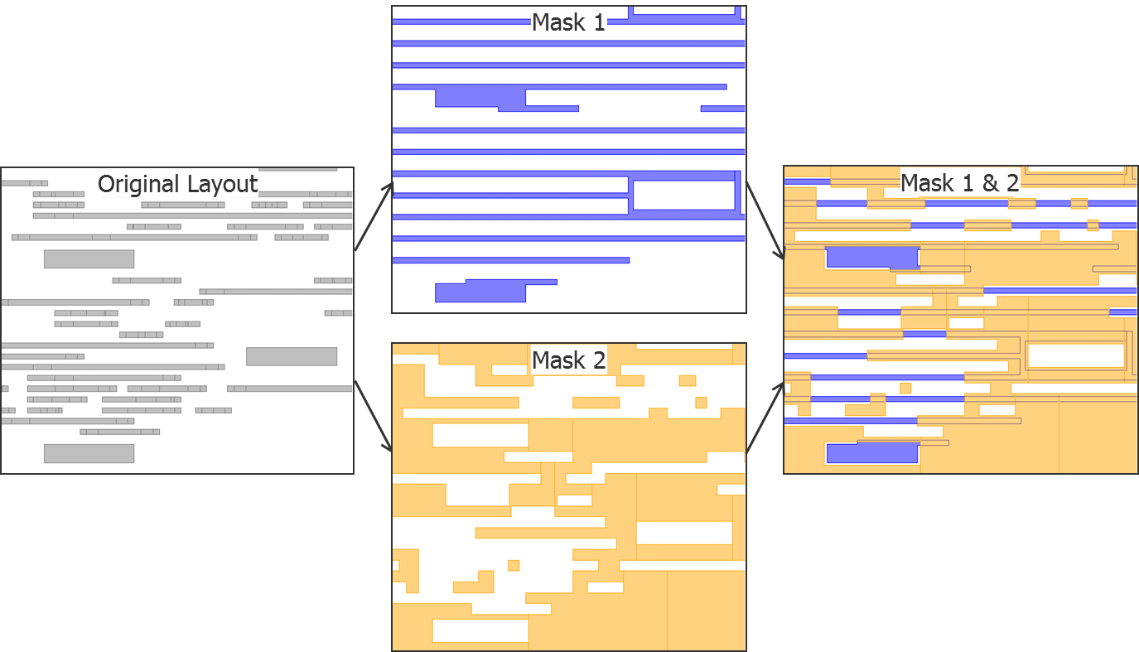
Trim Masks
Second SADP Lithography step is simpler than a second LELE Lithography step
Cheaper
Less Critical
https://semiengineering.com/self-aligned-double-patterning-part-one/

Slide 16
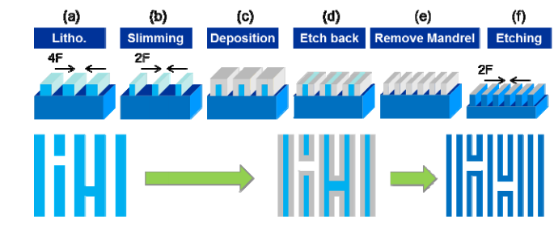
Self Aligned Quadruple Patterning
“Double SADP”
Doubles resolution
Two trim lithography steps
Nakatama, K; et al. SPIE 2012

Slide 17
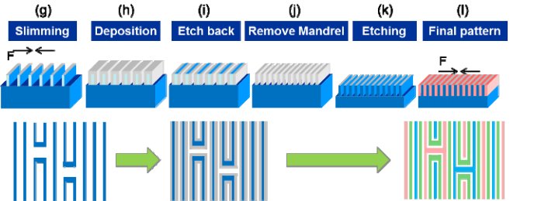
Self Aligned Quadruple Patterning
Nakatama, K; et al. SPIE 2012

Slide 18
SADP Problems
Not all patterns can be printed
Primary and secondary patterns can’t touch
https://http://www.aspdac.com/aspdac2013/archive/pdf/3C-4.pdf/

Slide 19
SADP Problems
Anti-parallel line ends
Trim masks overlap if they are too close
https://ieeexplore.ieee.org/document/7723830

Slide 20
SADP Problems
Turns are difficult to control
Unideal patterning results
https://ieeexplore.ieee.org/document/7723830

Slide 21
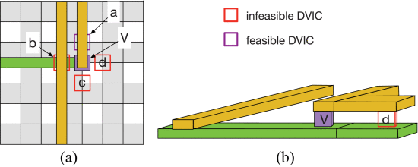
SADP Problems-Via Manufacturing
Via manufacturing with SADP or single patterning is not possible
Requires another double lithography technique
https://ieeexplore-ieee-org.ezproxy.lib.utexas.edu/document/7940014

Slide 22
Via Manufacturing
Double manufacturing with half absorbance
The common exposed areas are fully exposed

Slide 23
Via Manufacturing
After etching, unexposed areas form holes
Holes can be filled with a conductive via material

Slide 24
Via Manufacturing
Via connects different layers of materials
Other layers formed from other types of patterning

Slide 25
In Practice
Company | Logic Process | MMP Patterning Technique | Production Start
Intel | 14nm | SADP | 2014
Intel | 10nm | SAQP | end of 2018
TSMC | 16FF | LELE | 2015
TSMC | 10FF | SADP | 2017
TSMC | 7FF | SADP | early 2017
Samsung | 14LP* | LELE | 2015
Samsung | 10LPE | LELELE | end of 2016
Samsung | 8LPP | LELELELE | end of 2018
Global-Foundries | 7LP | SADP | 2018
Patterning Method | Normalized Wafer Cost
193i SE | 1
193i LELE | 2.5
193i LELELE | 3.5
193i SADP | 2
193i SAQP | 3
EUV SE | 4
EUV SADP | 6

Slide 26
Conclusions
SADP along with other multiple patterning techniques will continue to be useful
Combination of multiple patterning techniques
Design considerations will dominate what manufacturing method is used
Future innovations in multiple patterning are required to continue Moore’s Law until NGL’s are feasible

Slide 27
Questions?

Slide 28
References
Self-Aligned Double Patterning Lithography Aware Detailed Routing With Color Preassignment - IEEE Journals & Magazine, ieeexplore.ieee.org/document/7723830.
Self-Aligned Double Patterning-Aware Detailed Routing with Double via Insertion and via Manufacturability Consideration - IEEE Conference Publication, ieeexplore.ieee.org/document/7544285.
“Fill/Cut Self-Aligned Double-Patterning.” Semiconductor Engineering, semiengineering.com/fillcut-self-aligned-double-patterning/.
Mack, Chris. “Lecture 59 (CHE 323) Lithography Double Patterning.” YouTube, YouTube, 8 Nov. 2013, www.youtube.com/watch?v=Foush3X7dCc.
Nakayama, Koichi, et al. “Self-Aligned Double and Quadruple Patterning Layout Principle.” Search the World's Largest Collection of Optics and Photonics Applied Research., International Society for Optics and Photonics, 14 Mar. 2012, www.spiedigitallibrary.org/conference-proceedings-of-spie/8327/83270V/Self-aligned-double-and-quadruple-patterning-layout-principle/10.1117/12.916678.full.
“Self-Aligned Double Patterning, Part One.” Semiconductor Engineering, semiengineering.com/self-aligned-double-patterning-part-one/.
“Triple Patterning and Self-Aligned Double Patterning (SADP).” Tech Design Forum Techniques, www.techdesignforums.com/practice/guides/triple-patterning-self-aligned-double-patterning-sadp/.

